Slide 1
Full Stack Web Performance
loading
Nik Molnar    nikmd23

Slide 2
Why #perfmatters


Slide 3

self-actualization
pleasurable
esteem
“performant”
humans
belonging
usable
users
safety
reliable
physiological
functional
http://bit.ly/userNeedsHierarchy
Notes:
In 1943 Abraham Maslow proposed the theory of the human the hierarchy of needs (on the left). The gist is that humans have basic life needs that much be met before other, more advanced needs can be met. Maslow’s theory states that humans flourish when the top tier of their needs are met.
Aaron Walter suggests that users of software operate in a very similar hierarchy of needs, which I’ve slightly modified on the right.
Software a user interacts with must first and foremost be functional – they must solve a problem.
Next, they need to be reliable. We all remember the twitter fail whale and the pain that caused us.
The interface then needs to be useable. Useable interfaces are easy to learn, easy to use and easy to remember.
Once useable, they need to be “performant”, which is not really a word but very commonly used anyways. Once performant your users will deem your software as
PLEASURABLE!
Performance profiling actually plays a role in two of these steps:
Of course, performance profilers help us to identify non-performant code near the top of the hierarchy, but performance profilers can also help us to create reliable software too – especially in web development where non-performant code can impact the number of concurrent users accessing your service/site at any given time.
Of course if this is all too touchy feely for you, performance profilers help the bottom line. Google penalizes poorly performing websites in its search rankings, conversion rates begin to drop after just 100ms, and hardware costs decrease (vertically and horizontally) with code that is more performant, study after study shows that fast has to be a feature.

Slide 4

100 ms feels instant 1,000 MS Uninterrupted Thought 10,000 MS Lose attention
http://bit.ly/responseTimes
Notes:
There are 3 main time limits (which are determined by human perceptual abilities) to keep in mind when optimizing web and application performance. They were originally published in 1968, and re-confirmed by Jakob Nielsen again in 1993 and 2005.
0.1 second is about the limit for having the user feel that the system is reacting instantaneously, meaning that no special feedback is necessary except to display the result.
1.0 second is about the limit for the user's flow of thought to stay uninterrupted, even though the user will notice the delay. Normally, no special feedback is necessary during delays of more than 0.1 but less than 1.0 second, but the user does lose the feeling of operating directly on the data.
10 seconds is about the limit for keeping the user's attention focused on the dialogue. For longer delays, users will want to perform other tasks while waiting for the computer to finish, so they should be given feedback indicating when the computer expects to be done. Feedback during the delay is especially important if the response time is likely to be highly variable, since users will then not know what to expect.
These numbers are upper bounds, not goals.
Web apps have extra challenges because we need our users to both GET IT and USE IT

Slide 5
NETWORK


Slide 6
Fixes

HTTP Caching
Combine/Minify
Compression
ySlow Recommendations
Image optimization
Preresolve, Prerender, Prefetch
<script async> attribute – says I won’t doc.write
Stream/Flush HTML
Notes:
Do Less (Items & Bytes)
Do it later (procrastinate)
Do it sooner (anticipate)
Demo Network tab
If want to show off HAR, use HAR viewer: http://www.softwareishard.com/har/viewer/
THEN
Demo Audits, I have an Accessibility extension installed: https://chrome.google.com/webstore/detail/accessibility-developer-t/fpkknkljclfencbdbgkenhalefipecmb?hl=en
And then PageSpeed is basically an Audits extension
Perhaps demo RedBot here too in order to show off caching headers

Slide 7

async

<script async src="http://3rd-part.com/some.js"></script>
http://bit.ly/prebrowsing
Notes:
Async, do I demo this? If so how?
Use IE demo? http://ie.microsoft.com/testdrive/Performance/AsyncScripts/Default.html

Slide 8
prebrowsing

<link rel="dns-prefetch" href="domain.com">
<link rel="prefetch" href="http://domain.com/asset.ext">
<link rel="prerender" href="http://domain.com/">
http://bit.ly/prebrowsing
Notes:
DNS prefetch works in all the newest versions of all browsers
Test at prebrowsing.com
Prefetches should be cacheable
Prerender is like swapping in a hidden tab, so caching doesn’t matter. JS is executed but respects the pageVisiblity API. Don’t do this willy nilly. Chrome OmniBox uses this.
chrome://net-internals/#prerender + http://prerender-test.appspot.com/ + task manager is a cool demo

Slide 9
Server

Slide 10
Fixes
Ants Profiler
List of things to avoid
ASP.NET tips
Remove unused View Engines
Avoid running sites in debug mode

Slide 11
SQL?

Slide 12
Fixes
Indexes or anything else??

Slide 13
Compute


Slide 14
Fixes

FlameChart and profilers in ChromeDev Tools Lookup how to use

Slide 15
Render


Slide 16
Fixes

Show paint rectangles
Show compositied layer boarders
Enable continuous page painting
Add Writes then All Reads
RequestAnimationFrame
TranslateZ
Avoid making changes during scrolling
Notes:
TranslateZ is one of several ways to promote a layer, others include:
Hardware accelerated <video> element
Hardware accelerated <canvas> element
Composited plugins like flash/Silverlight
CSS opacity animation
Animated webkit transform
Accelerated CSS filters
Rendered ontop of another layer

Slide 17
Notes

Function Call [Yellow]
Recalculate Style/Layout (purple)
Get all Style rules, Evaluate Selectors and Match to DOM, Calculate the Computed Style for all elements
Layout issues point to bad JS
Paint [Green]
Debug w/ continuous paint mode
USE ‘H’ KEY TO HIDE ELEMENTS TO EXPLORE WHICH ONES COST
Notes:
Composite Layers is when rasterized images are sent from CPU to GPU

Slide 18
Notes

1000 ms / 60 fps = ~16 ms

Slide 19
Notes

16 ms
16 ms
16 ms
16 ms
16 ms

Slide 20
Notes

requestAnimationFrame()
rAF
JS
Paint
16 ms
16 ms
16 ms
16 ms
16 ms

Slide 21
Notes

dropped frame
rAF
JS
Paint
rAF
JS
Paint
rAF
JS
Paint
rAF
16 ms
16 ms
16 ms
16 ms
16 ms
Notes:
Composite Layers is when rasterized images are sent from CPU to GPU

Slide 22
Notes

.items div
{
width: 60px;
color: #FFF;
}
■ Recalculate Style
■ Layout
■ Paint
Notes:
Show list of tags and what they affect?

Slide 23
Notes

Four jank free actions:
Scale: transform: scale(x)
Move: transform: translateX(y)
Rotate: transform: rotate(z)
Fade: opacity: 0…1

Slide 24

Psychology?

Slide 25
perceived improvement
yield
execution time
complexity

Slide 26
Tools
✴

Slide 27
✴
PageSlow/Yspeed
webpagetest.org – show off Speed Index

Slide 28
Resources
−

Slide 29





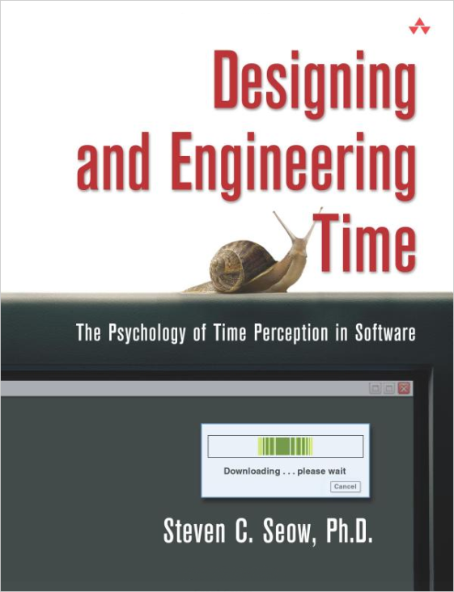


−

Slide 30

Questions?
Full Stack Web Performance Nik Molnar    nikmd23
http://bit.ly/full-stack-web-perf

